Slide 1
NEXT GENERATION NETWORK
CIS SABARAGAMUWA
2011 AUGUST

Slide 2

Telecom Network in Summary
LE
Local EX
LE
03
Domestic Transport
LE
LE
International Transport
LE
LE
IEX
Access
02
IEX
01
Land line
IEX
IEX

Slide 3








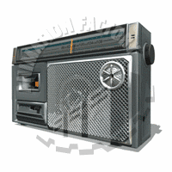


A house has 3 different Communication Types
Voice
Video
Data
Land Phone
IP/TV
Internet
Mobile
Free TV (Antenna)
Cable TV
Satellite TV
E-mail
Radio

Slide 4

Who are the service providers in Sri Lanka?
Cable TV
Free TV (Antenna)
IP/TV
Satellite TV
Mobile
Radio
Internet
E-mail
Land Phone

Slide 5























Who are the service providers in Sri Lanka?
Cable TV
Total = 4
Free TV (Antenna)
IP/TV
Satellite TV
Mobile
Total = 7
Radio
Internet
Total = 42
E-mail
Land Phone

Slide 6
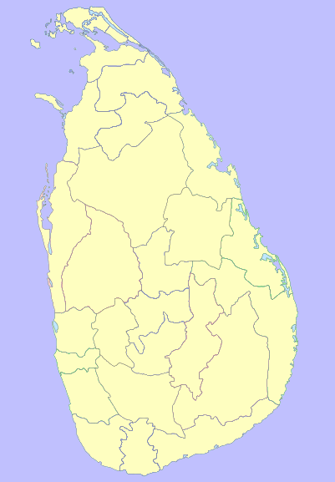













Who are the service providers?
Cable TV
Free TV (Antenna)
IP/TV
Satellite TV
Mobile
Radio
Internet
E-mail
Land Phone

Slide 7

















Who are the service providers?
Cable TV
Free TV (Antenna)
IP/TV
Satellite TV
Mobile
Radio
Internet
E-mail
Land Phone

Slide 8

Communication Types
Personal Communication
Interactive
Land Phone
You need Bi-Directional
Transmission
Delayed Interactive
Mobile
Public Communication
Free TV
Internet
Cable TV
E-mail
You need only uni-Directional
Transmission
Radio
Satellite TV
IP/TV
Sub-core Elements
MSAN
BroadBand
Studio / Service provision
International Transport Network
Core Element
Soft Switch / Switches
Domestic Transport Network
International Gateway

Slide 9

A Converge Network

Slide 10

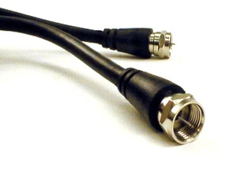
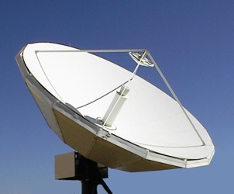
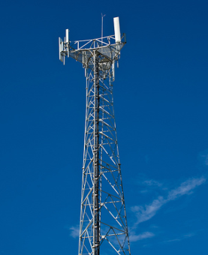

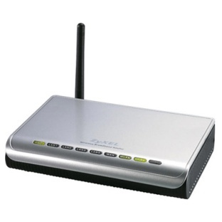

A house got 3 different Communication Types
Voice
Video
Data
How it access home?
Land Phone
Internet
Voice
Mobile
Free TV (Antenna)
Satellite TV
Cable TV
E-mail
Wireless
Wire
Wireless
Data
Wireless
Wire or Wireless
Wire
Video

Slide 11
WHO ARE THE BENIFICIARIES OF A CONVERGED NETWORK
CITIZEN & GOVERNMENT OF THAT COUNTRY
WHY?
CUSTOMERS WILL BE BENEFITTED WITH HAVING ONE TERMINAL TO OPERATE ALL VOICE , DATA & VEDIO SERVICES. FURTHER THEY WILL BE BENIFITTED WITH HAVING ONE ACCESS LINE TO MAINTAIN AT HOME.
CUSTOMERS CAN CHOOSE THE SERVICES INDEPENDENT OF THE NETWORK PROVIDER, AND THE SERVICE PROVIDER CAN ATTRACT THE CUSTOMERS ON BETTER VALUE PROGRAMMES, INDEPENDENT TO THE NETWOPRK PROVIDER.
IS SERVICE & NETWORK PROVIDERS ARE BENIFITTED?
YES. CUSTOMERS WILL BE ATTRACTED TO THE INOVATIVE PRODUCTS

Slide 12
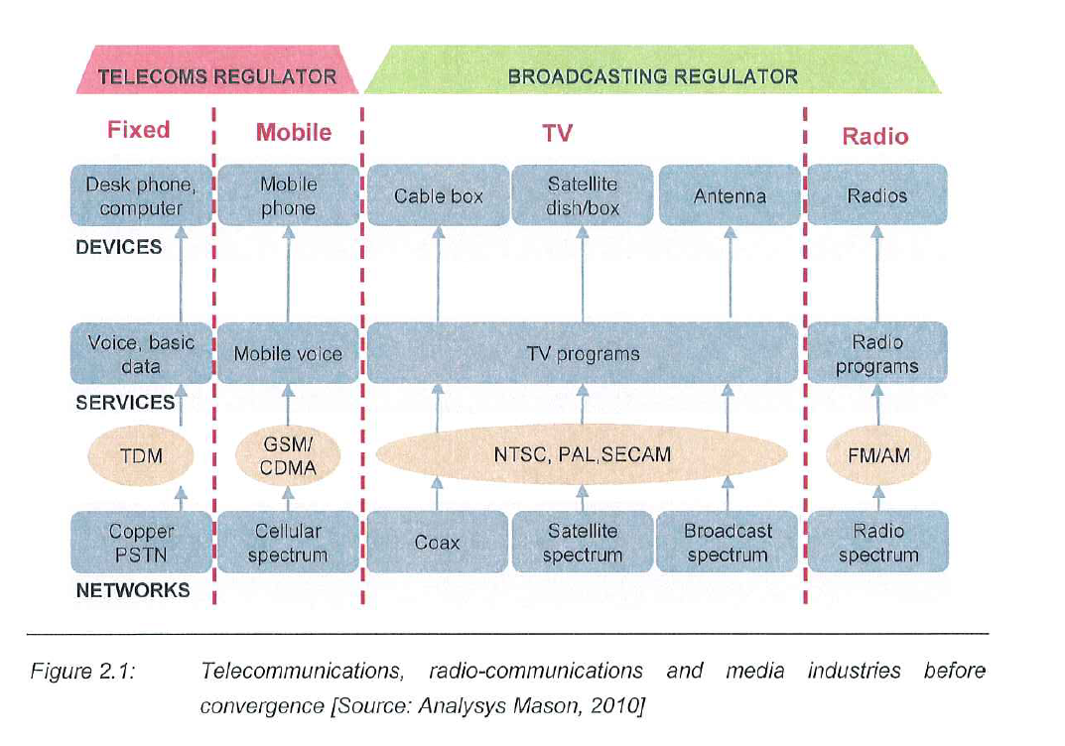
IMPACT OF CONVERGENCE

Slide 13
THE PROCESS OF CONVERGENCE
NETWORK CONVERGENCE
NGN NETWORK- THE ABILITY TO CARRY IP PACKETS OF VARIOUS NETWOKRS what are the protocols used. How we make the interconnection billing
SERVICE CONVERGENCE
THE INCREASED ABILITY TO OFFER ANY SUBSET OF VOICE, DATA,VEDIO SERVICES OVER A PARTICULAR IP ENABLED NETWORK. Any examples?

Slide 14
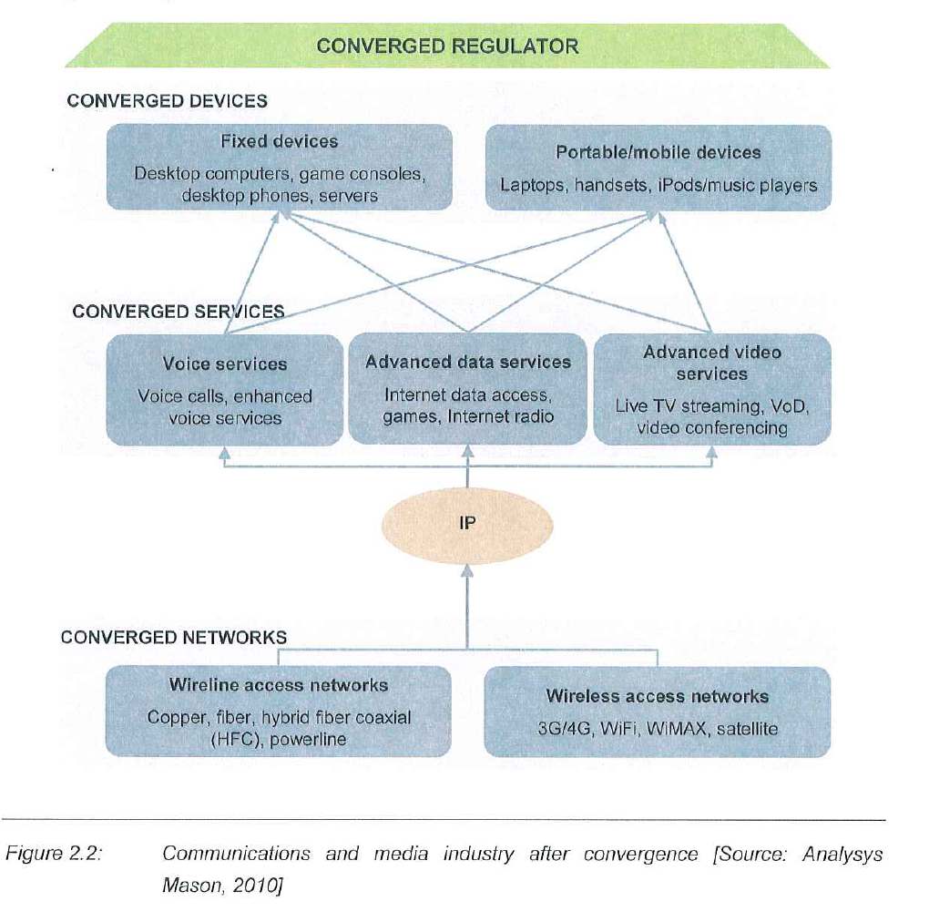
STRUCTURE OF CONVERGED MEDIA & COMMUNICATION NETWORK

Slide 15
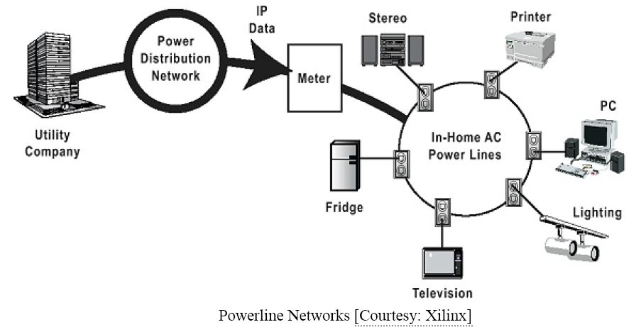
Power Line Communication System

Slide 16
Global Capacity Trend
WORLD INTERNET USAGE AND POPULATION STATISTICS
World Regions | Population (Est 2007) Million | Population % of the World | Internet Usage, Latest Data (Million) | % Population ( Penetration ) | Usage % of World | Usage Growth 2000-2007
Africa | 933 | 14.2% | 34 | 3.6% | 2.9% | 643.1%
Asia | 3,713 | 56.5% | 437 | 11.8% | 37.2% | 282.1%
Europe | 810 | 12.3% | 322 | 39.8% | 27.4% | 206.2%
Middle East | 193 | 2.9% | 20 | 10.1% | 1.7% | 494.8%
North America | 335 | 5.1% | 233 | 69.5% | 19.8% | 115.2%
Latin America/Caribbean | 557 | 8.5% | 110 | 19.8% | 9.4% | 508.6%
Oceania / Australia | 34 | 0.5% | 19 | 54.5% | 1.6% | 146.7%
WORLD TOTAL | 6,575 | 100.00% | 1,173 | 17.84% | 100.00% | 225.00%
Source: www.internetworldstats.com

Slide 17
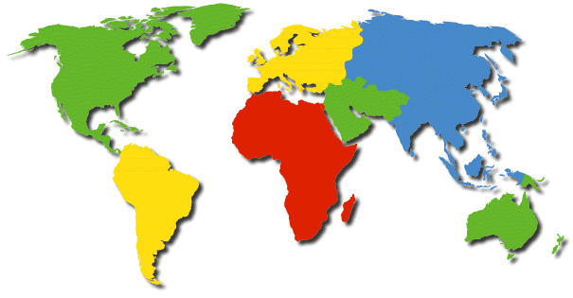
Current Estimated Capacities between Continents
Europe
810 Million
North America
335 Million
Asia
3.7 Billion
6Tbps
12Tbps
Middle East
193 Million
6Tbps
2-3Gbps
5Tbps
9Tbps
8Tbs
Africa
933 Million
Latin America/
Caribbean
557 Million
Oceania/
Australia
34 Million

Slide 18
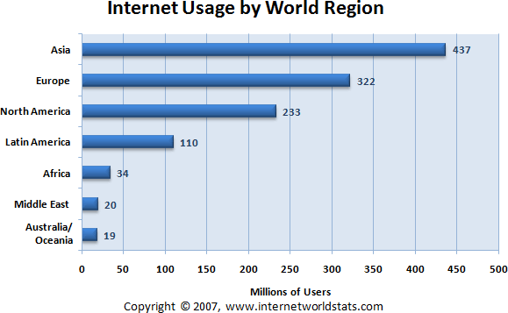
Internet Usage by World Region

Slide 19
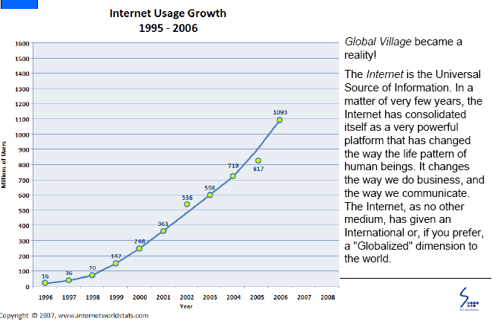
Explosive Growth of Internet

Slide 20
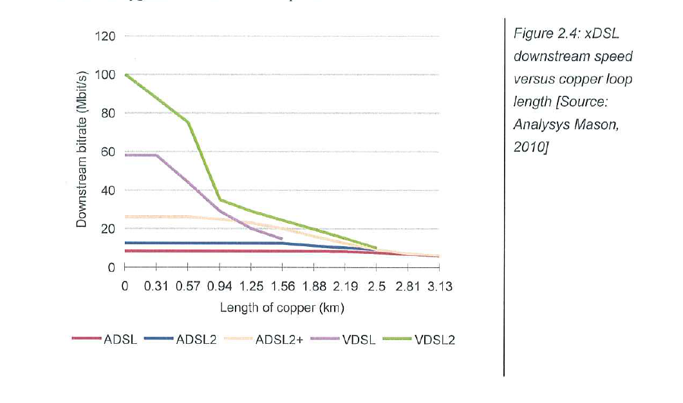
APPLICATION OF VARIOUS TECNOLOGIES INTO WIRED NETWORK

Slide 21
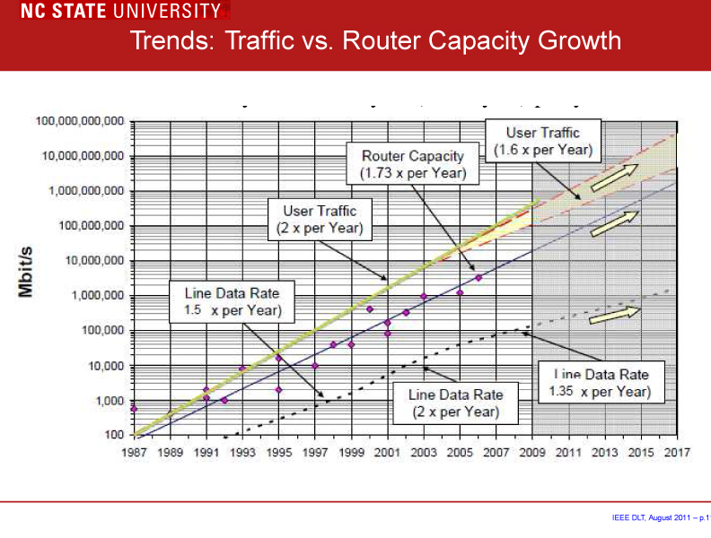

Slide 22
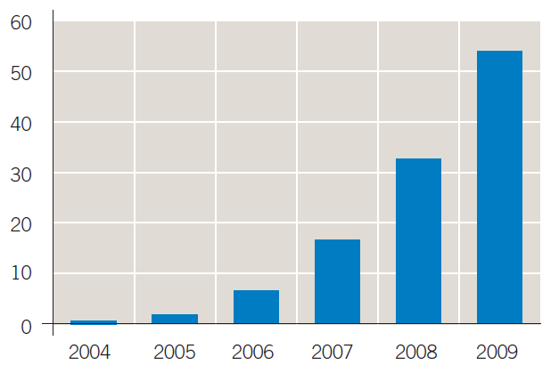
Global IPTV Subscribers (in Millions)
Figure 1. Global IPTV subscribers (Source: Infonetics Research — “IPTV Equipment,
Services and Subscribers,” 2005)

Slide 23
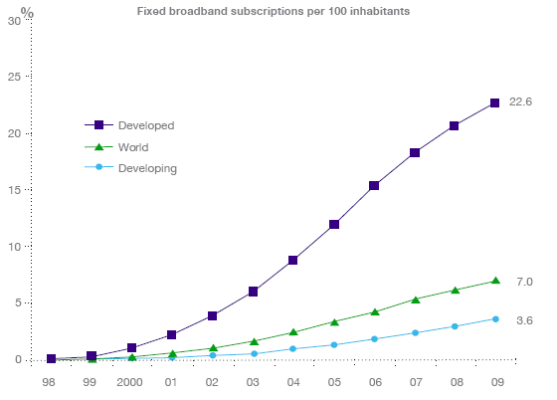
Global Trend in Broadband
Source: ITU World Telecommunication/ICT Indicators database

Slide 24
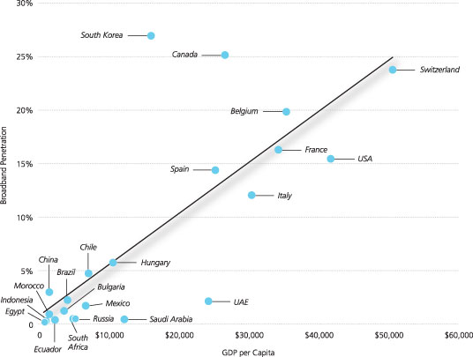
Broadband Penetration and Development
GLOBAL TREND
Source: Alcatel lucent

Slide 25
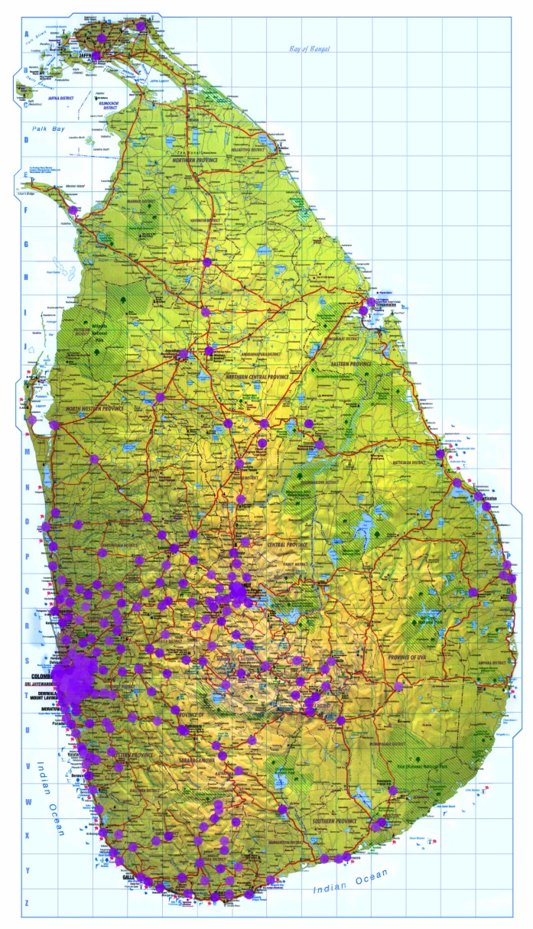
FIXED BROADBAND CUSTOMER DISTRIBUTION OF SRILANKA

Slide 26
Overall benefits of NGN network to Sri Lanka
Quicker we embark on NGN quicker Sri lanka become the hub of the South Asia

Slide 27
NGN networks major components
Services can be provided by fixed or wireless

Slide 28
Definition of NGN
.
NGNs essentially involve the replacement of all the different legacy networks with a single unified network, based on Internet protocol (IP) technology, which will provide all the different types of services.
The International Telecommunications Union (ITU) provides the following more formal definition of NGN in its Y.2001 Recommendation:
A Next Generation Networks (NGN) is a packet-based network able to provide Telecommunication Services to users and able to make use of multiple broadband, QoS-enabled transport technologies and in which service-related functions are independent of the underlying transport-related technologies. It enables unfettered access for users to networks and to competing service providers and services of their choice. It supports generalised mobility which will allow consistent and ubiquitous provision of services to users.
ITU-T Recommendation Y.2001, ITU, December 2004 – General overview of NGN

Slide 29
Passive optical fibre network architecture
Apon has a point to multipoint FTTH passive architecture using optical splitters(generally
16 to 1024 terminals(ONT=Optical Network Terminations)

Slide 30
P2P-Point to point optical network architecture
Each end user has its own dedicated fibre from the exchange with a very high speed and high cost

Slide 31
Different NGA architectures will result in different band width to the end user
The average bandwidth we can expect from each type of NGA Archtecture is given below
Technology | Typical Bandwidth per user (Mbit/s)
Existing copper Local Loop (baseline) | 2–5
Fibre to the cabinet (FTTC) | 30–50
Fibre To The Home (FTTH – PON) | 80–100
Fibre To The Home (FTTH – P2P) | 100

Slide 32
Wireless access technology for NGN
Long term evolution (LTE) and WiMAX becoming most promising technologies

Slide 33
IP-based interconnection between two NGNs
The ultimate NGN network interconnection (P2P)

Slide 34
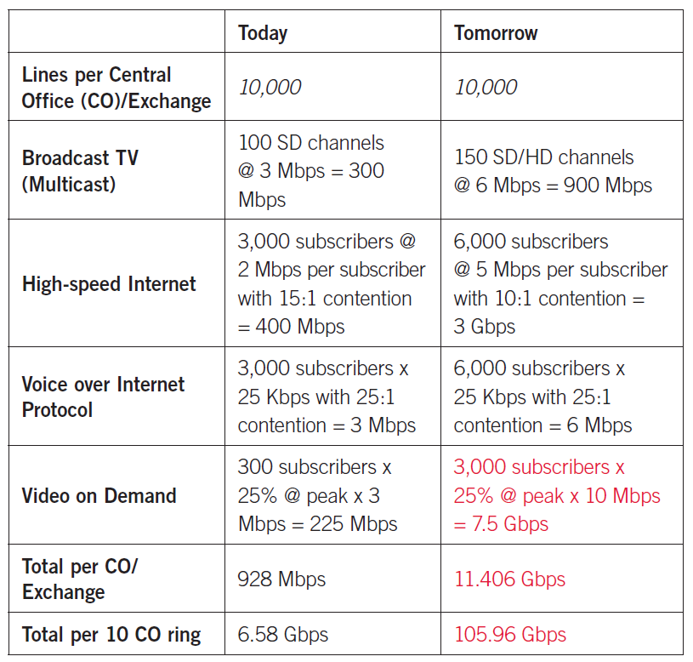
Triple-play metro evolution

Slide 35
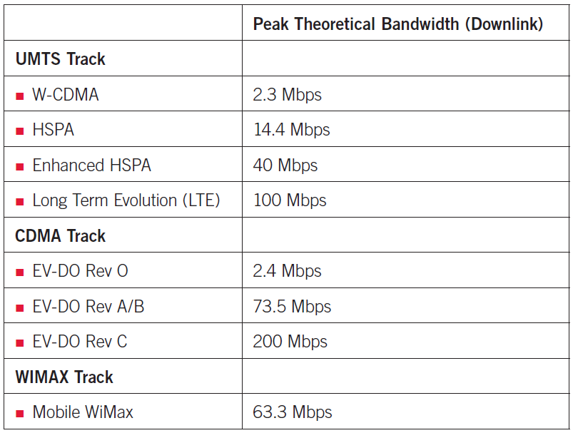
Peak theoretical bandwidth for mobile broadband technologies

Slide 36
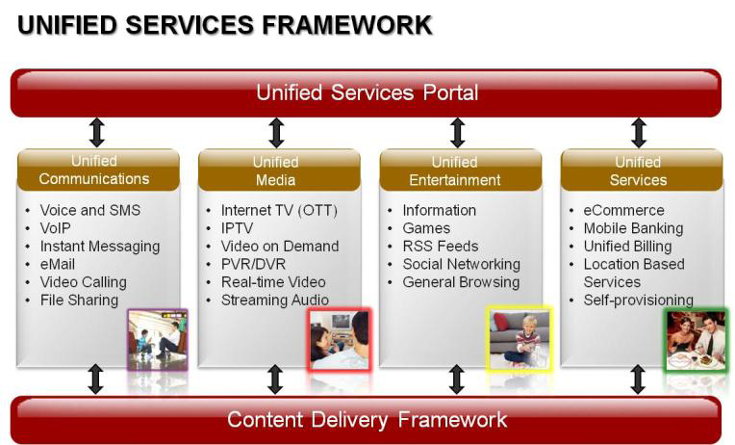
NGN SERVICES

Slide 37

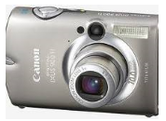
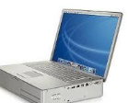


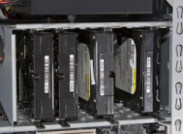



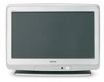

Devices have made significant gains from 1998…
Casio’s new digital camera featured 1024 x 768 resolution
Analog cell phones were still widely used
The Powerbook G3 had a 300Mhz processor, zip drive and a 5.0 GB hard drive
The most prevalent internet connection was a 56kbps dialup modem
Stacked hard drives afforded computer users ample space
to store files
Wi-Fi was still in its infancy
The first commercial
bluetooth products
began coming out only
in 1998
The Walkman combined the ability to listen to tapes and the radio on-the-go
GPS products were still
in their infancy
Sony released their concept flat-screen model TV in 1998
DVDs were beginning to overtake VHS tapes but many families began purchasing dual-mode players

Slide 38
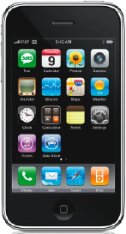
... all of which can now be incorporated into one device
The iPhone features a 2.0
megapixel camera
The iPhone operates on the new 3G
networks
The iPhone uses a 667Mhz
processor, more than
double top 1998 processing
speeds
The 3G network has maximum
download speeds of 7.2 Mbps
The iPhone automatically
connects to the nearest
WiFi station
With a 16 GB capacity, there
is roughly triple the hard
drive space than most
desktops in 1998
Bluetooth is now
ubiquitous in cell phones
and is present in some
vehicles
Roughly 360 albums can be
Held on the iPhone
The iPhone can overlay
satellite images onto the
users coordinates
The iPhone has 3.5 inch
Widescreen multi-touch display
YouTube, along with multiple forms of video, can be viewed on the iPhone

